Slide 1
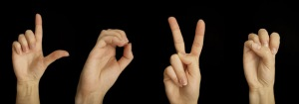
SIGNIA :SIGN LANGUAGE TRANSLATOR
TEAM REVELION : VIBHOR SHARMA
VIVAN JAISWAL,PRIYASHA SINGH, MIKHAIL KHAN

Slide 2
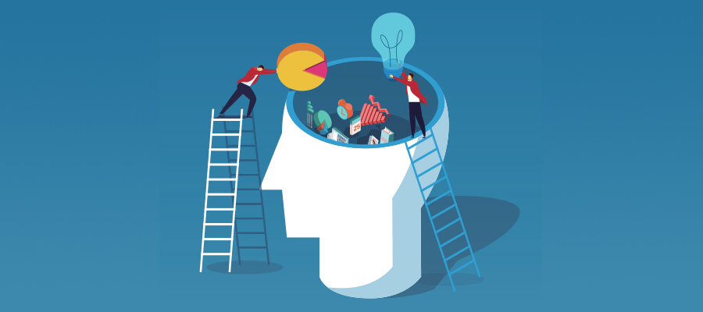
The Problem
Speech impaired people use hand signs and gestures to communicate.
They face difficulty in communicating with other people.
There is a need of a system which recognizes the different signs, gestures etc. of various SLs and conveys it to everybody in a manner they can understand. It bridges the gap between SL users & the rest of human society.
2.5 billion people are projected to have some degree of hearing loss and at least 700 million will require hearing rehabilitation.
The number of deaf-mutes in the world are roughly calculated to be from 700,000 to 900,000," and of these 63 percent, are said to be born deaf, the others losing their hearing by different accidents
They face social exclusion and deprived of various social activities.

Slide 3

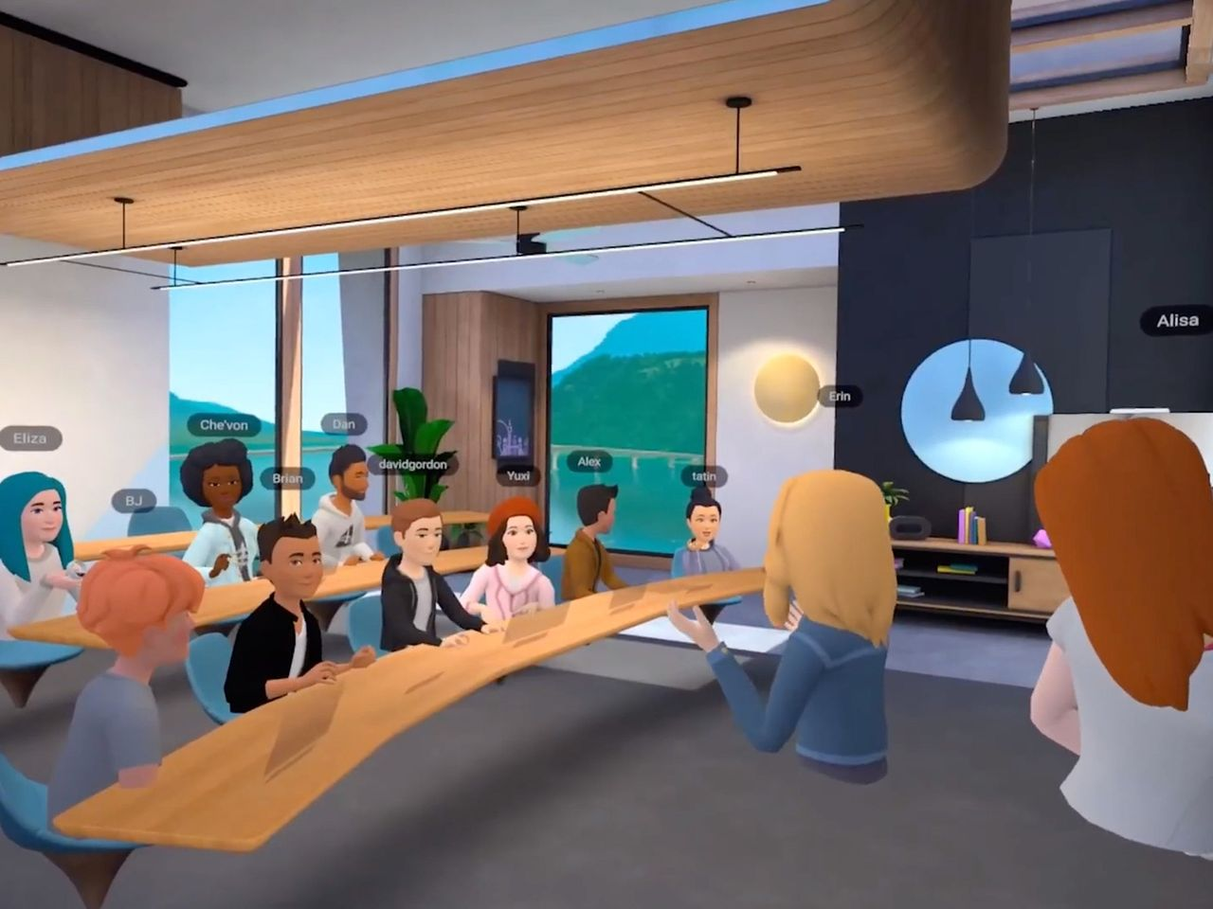
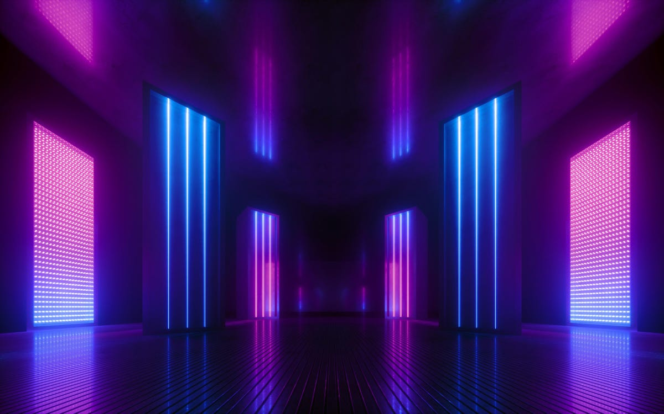
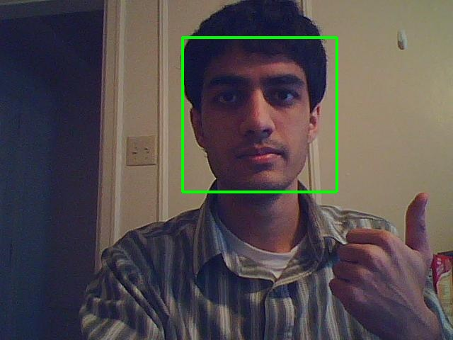
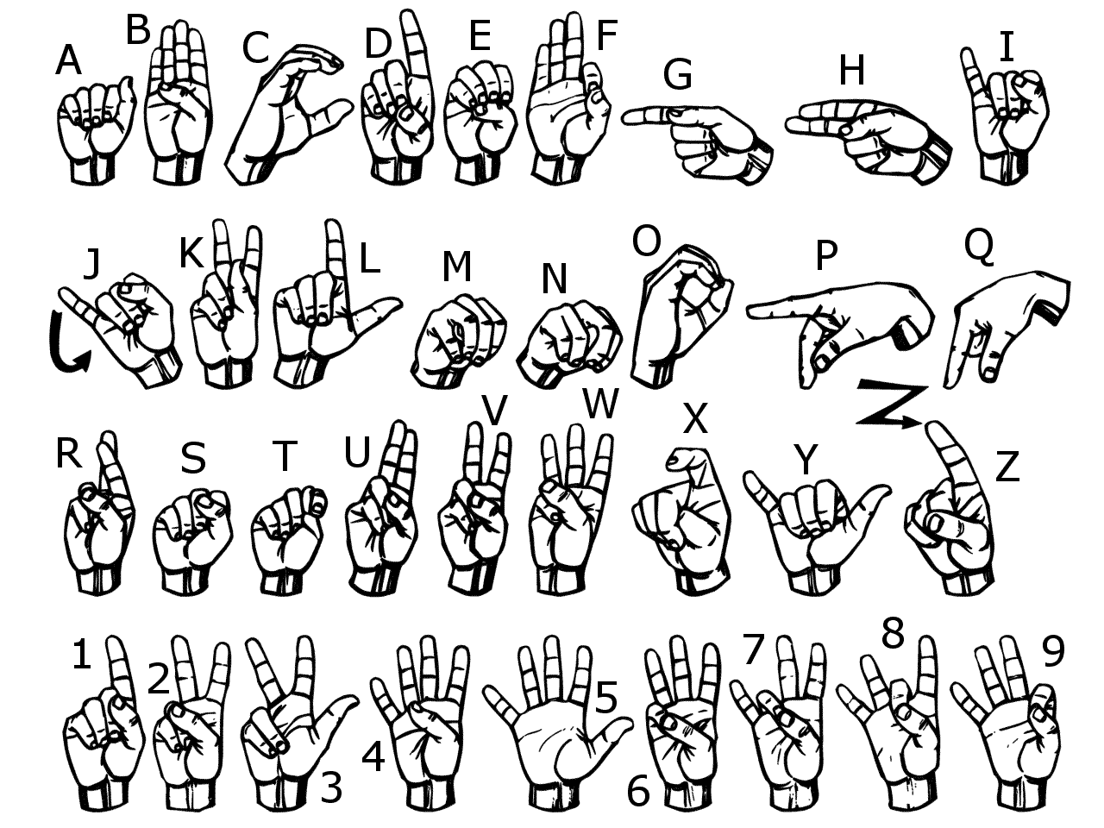
Idea
It is an application for automatic, translation of sign language and detection using image processing , ai /ml ,CNN.it is used for Our project focuses on the problem of recognizing in real time the sign language (SL) used by communities of deaf and/or dumb people.
The problem is addressed by experimenting with different segmentation approaches and unsupervised learning algorithms to create an accurate sign language recognition model.
Usina Image Acquisition Facture Extraction Orientation Détection Gestuel Recognition process web maker communication casier and quitte intersecting interactive and intersecting waw for déshabilites and maker théier life bette.
This Photo by Unknown Author is licensed under CC BY

Slide 4
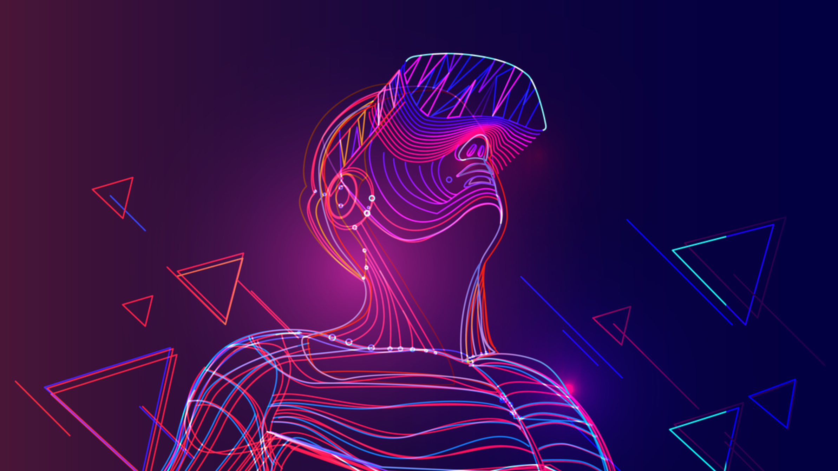
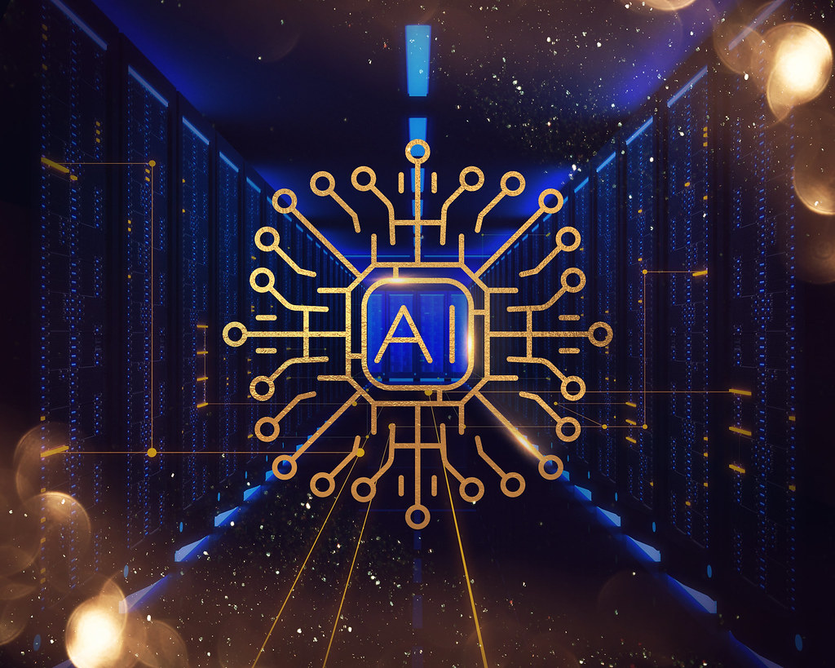
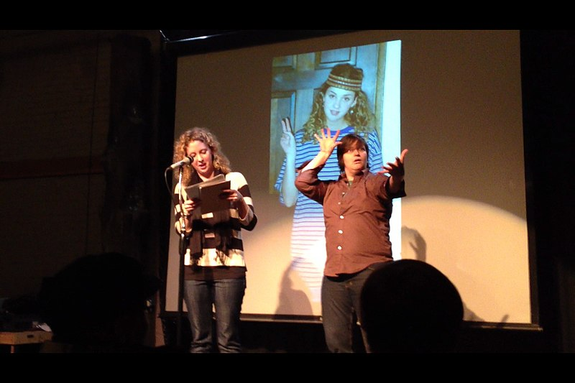

Features
Better than traditional ways of teaching
Sign language translation to English German , Japanese's model etc.
Image processing and selection using ai/ml.
Picture display output
Model visualisation, more interactive and entertaining
Image acquisition
Facture extraction
Orientation détection
Gesture recognition process

Slide 5

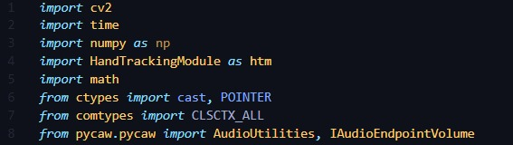
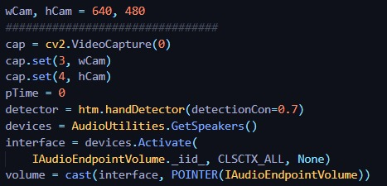
PROTOTYPE AND CODE :

Slide 6
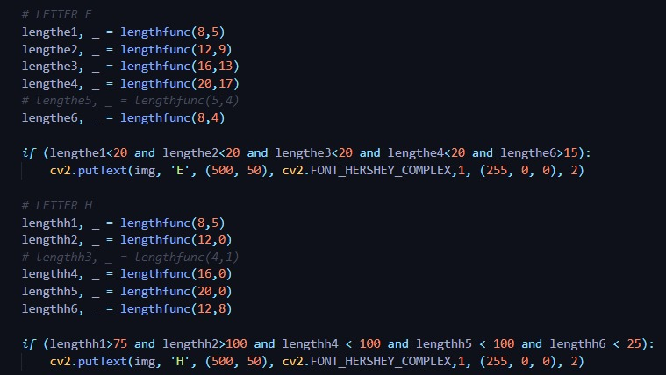
PROTPROTOTYPE AND CODE

Slide 7
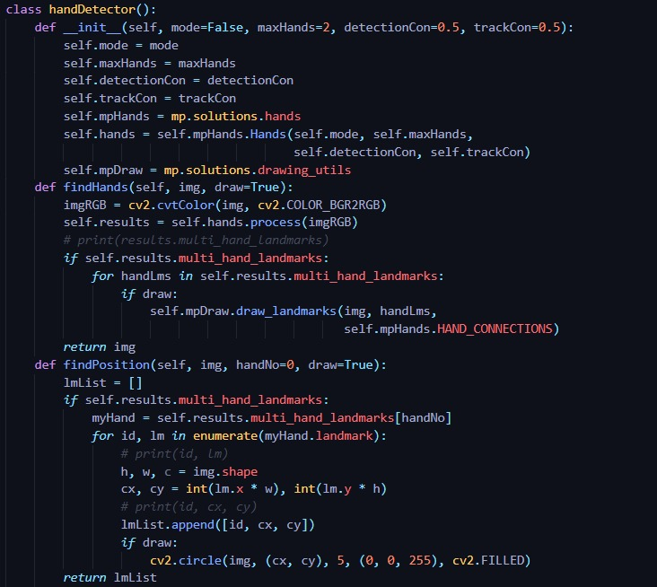
DETECTION AND TRACKING OF HAND LAND MARKS:

Slide 8
FLOW CHART OF PROCESS:
IMAGE PROCESSING AND SIGN DETECTION
NORMALIZATION
SIGN RECOGNITION
SIGN TO TEXT CONVERSION

Slide 9

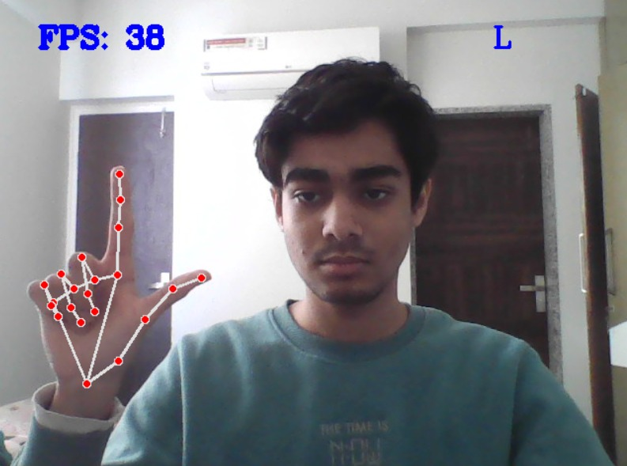
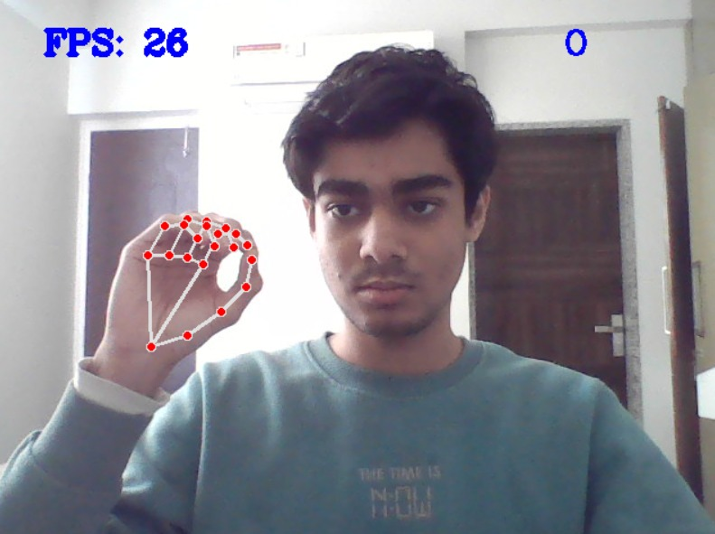
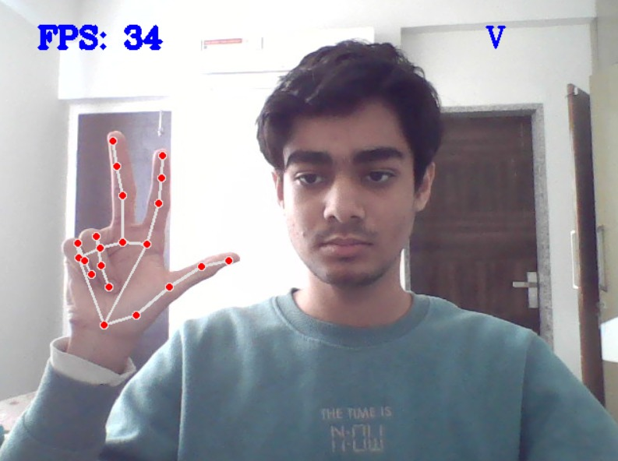
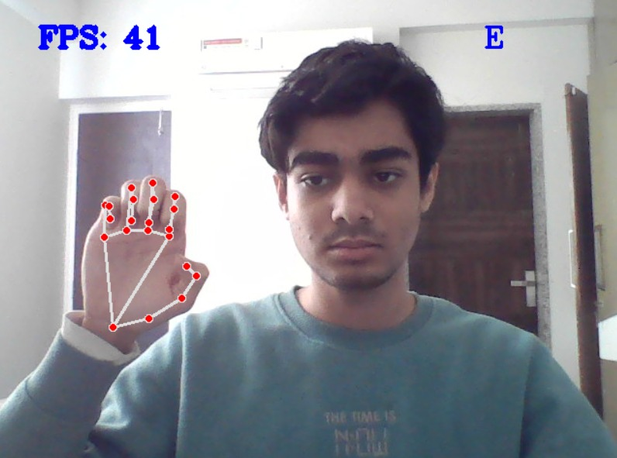
IMAGE PROCESSING USING AI AND CNN OUTPUT DISPLAY:
L
O
V
E
Image Acquisition
Feature Extraction
Orientation Detection
Gesture Recognition

Slide 10
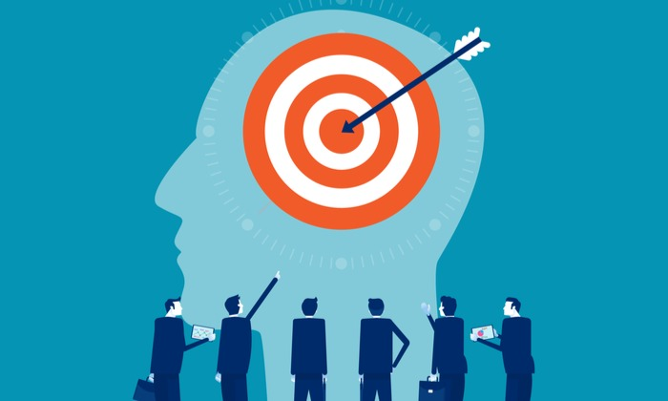
| Target Market
DISABLED CHILDREN ADULTS AND OLD PEOPLE
DEAF AND DUMB
SCHOOLS AND REHABILATION CENTRES
MEDICAL HOSPTITALS
NGO
BUSINESS FIRMS,CONTRACTERS , EDUCATIONAL COACHING INSTITUTE.
GOVERENMENT INCUBATION CENTRES AND WHO BODIES.
COUNTRIES : EU, GERMANY , JAPAN, AMERICA, INDIA , CHINA,ARAB NATIONS.
WITH FUTURE PLANS, WE WILL BE TARGETING TYPE OF AUDIENCE WITH SUBSCRIPTION MODEL, B2B MODEL AND CONTRACT BASED MODEL.

Slide 11

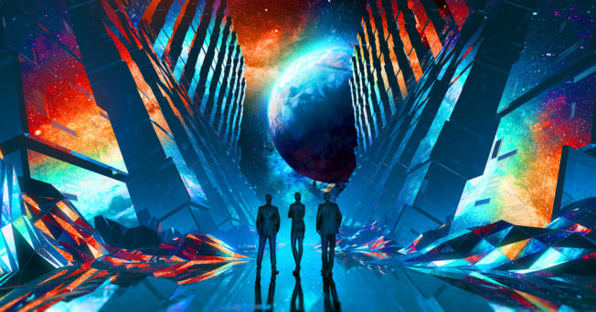

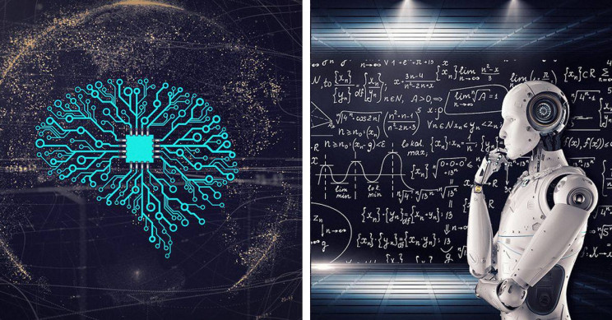
TECH-INSIGHTS
AI AND ML ,CNN,OPEN CV, PYTHON ETC.
OPENCV - IMAGE INPUT AND PROCESSING
PYGAME - AUDIO CONTROL (FOR TTS)
GTTS – GOOGLE TEXT TO SPEECH
PYQT5 – GUI FRAMEWORK
MEDIAPIPE - AI AND CNN

Slide 12

BUSINESS MODEL:our model is an app using python , ai ml open cv to solve a human issue and work for society .

Slide 13

| Marketing Strategy

Slide 14
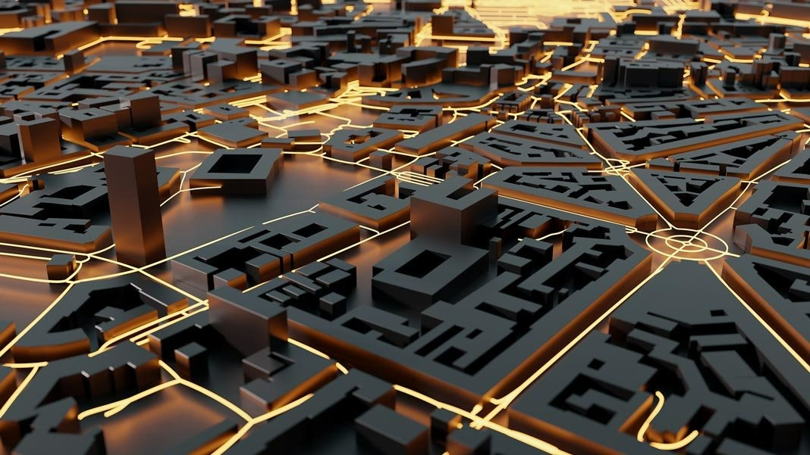
FUTURE PLANS AND FEATURES
AUTOMATIC SPEECH RECOGNITION.
GRAMMER AND ADVANCE LECTURE AND TUTORIAL
USE OF 3D MODEL FOR BETTER ILLUSTRATIONA AND VISUAL GRAPHICS
CONVERSION TO ALL KIND OF LANGUAGE MODEL
EXTENTION TO MOBILE APPLICATION
SENTENCE AND SONG, AUDIO AND VIDEO DETECTION USING NEURAL NETWORKING WITH ADVANCE TECHNOLOGY
IMPLEMENTING OF GENETIC ALGORITHM FOR SIGN DETECTION
ORIENTATION MANAGEMENT
REAL TIME WORLD RECOGNISTION
COLOUR DETECTION AND IMAGE OMPTIMIZATION

Slide 15
THANKS

